Slide 1
Decision Trees
Ali El-Kassas

Slide 2
Outline
Quick Recap
Interactive Game
Decision Trees Terminology
Hands-On in Python

Slide 3
Objectives
Understand the core concepts of decision trees
Learn how to build and evaluate decision tree models

Slide 4
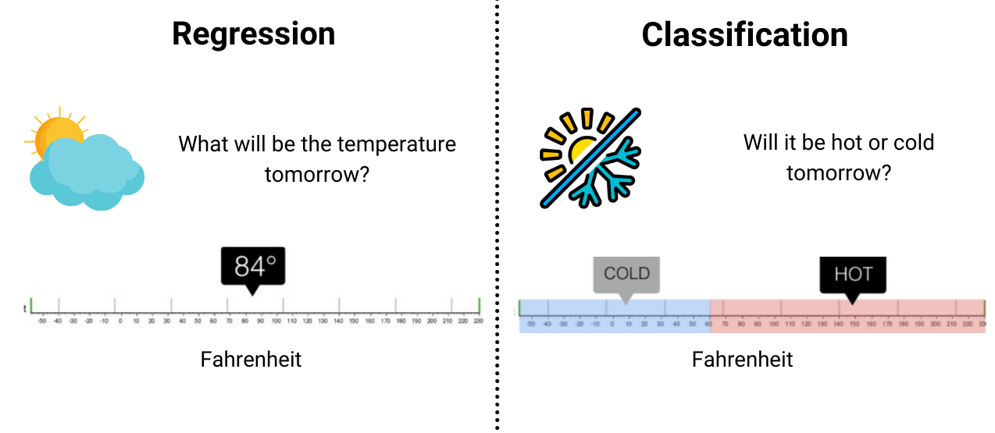
Recap: Regression vs Classification

Slide 5
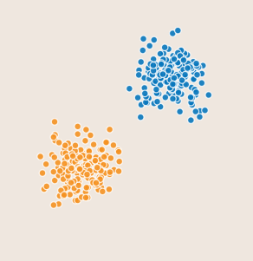
Recap: Linear Model

Slide 6
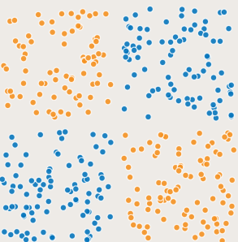
Recap: Linear Model

Slide 7
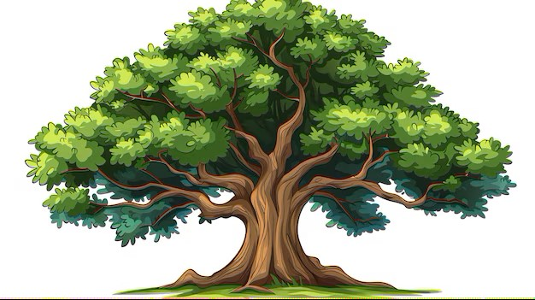
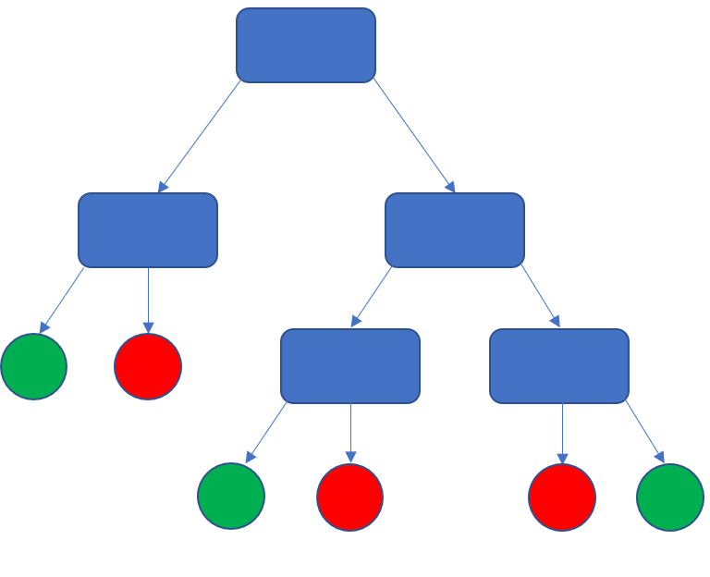
Tree

Slide 8



Why Trees?
Very powerful modeling method (non-linear)
Works for classification and regression
“Interpretable”

Slide 9

Animal Guessing Game
Guess the animal
Pair up randomly
One person thinks of an animal
The other guesses by asking up to five yes/no questions
Notes:
Game rules: Choose Partners: Everyone will be paired up randomly.
Think of an Animal: One person in each pair will think of an animal in their head.
Guess the Animal: The other person will try to guess what animal their partner is thinking of.
Ask Questions: The guessing partner can ask up to seven yes or no questions to try to figure out the animal.

Slide 10

Animal Guessing Game
Lets guess from three animals: Penguin, Spider and Dog
Does the animal have more than 2 legs?
Yes

Slide 11

Animal Guessing Game
Does the animal have more than 2 eyes ?
No

Slide 12

Animal Guessing Game
Does the animal have more than 2 legs? Yes
Does the animal have more than 2 eyes? No

Slide 13
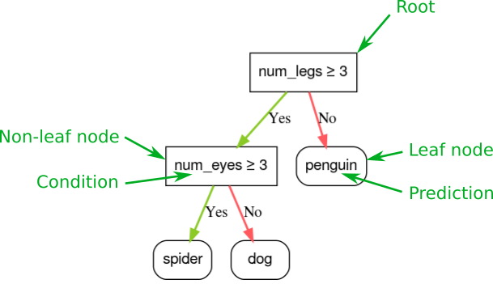
Decision Tree Terminology

Slide 14
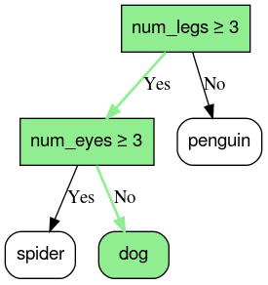
Decision Tree Prediction

Slide 15
Check your understanding
The inference of a decision tree runs by routing an example...
A. From one leaf to another.
B. From the root to the leaf.
C. From the leaf to the root.

Slide 16
Check your understanding
The inference of a decision tree runs by routing an example...
A. From one leaf to another.
B. From the root to the leaf.
C. From the leaf to the root.

Slide 17
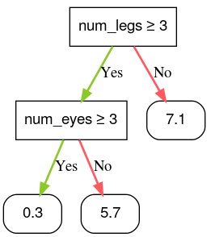
Regression
Predict a numerical cuteness score of an animal

Slide 18
Hands-On in Python
https://colab.research.google.com/drive/1ybNugy8GIcdyQoJ5eayv2FD0H9gV72Gf?usp=sharing

Slide 19
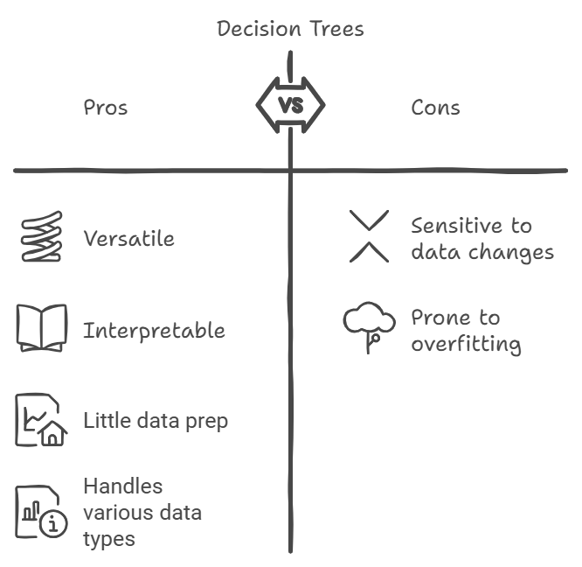
Summary

Slide 20
References
Decision trees | Google for Developers
Decision Trees Visually Explained
uclaacmai/ML_Practical
Sklearn docs

Slide 21
Thank you! Any Questions ?

